Slide 1
Features III: Advanced Descriptors
D E P A R T M E N T O F C O M P U T E R S C I E N C E U N I V E R S I T Y O F C O P E N H A G E N
Kim Steenstrup Pedersen
Notes:
Forelæsning: 21 (2013)
21 (2014)

Slide 2
Plan for today
Again we consider the problem of matching two or more images
Today we look at advanced descriptors
We end by looking at a comparative study of state of the art descriptors

Slide 3
Matching Strategy Illustrated
Notes:
Find potential matches – in principal we can have several candidates

Slide 4
Salient Feature Matching Strategy
For a pair of images:
Extract salient points, via detectors e.g. Harris corners, DoG (blobs), MSER
Compute Feature descriptors, eg. Raw patch (correlation), SIFT, DAISY
Match features by pairing similar descriptors
Aggregate solution to multiple images, if needed.

Slide 5
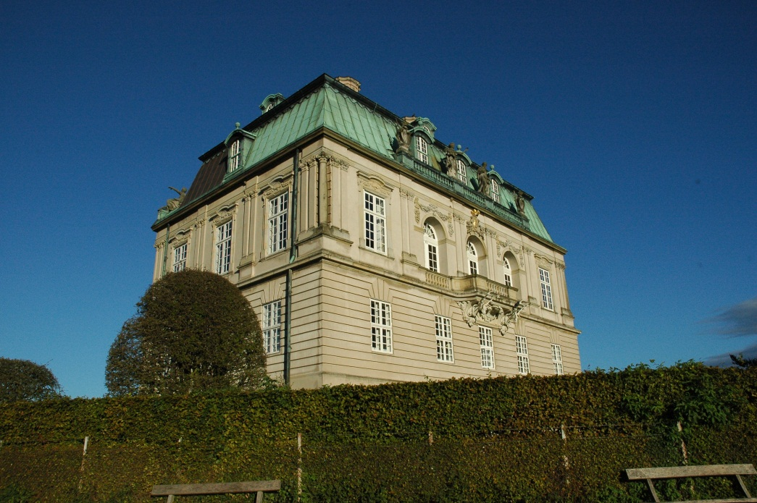
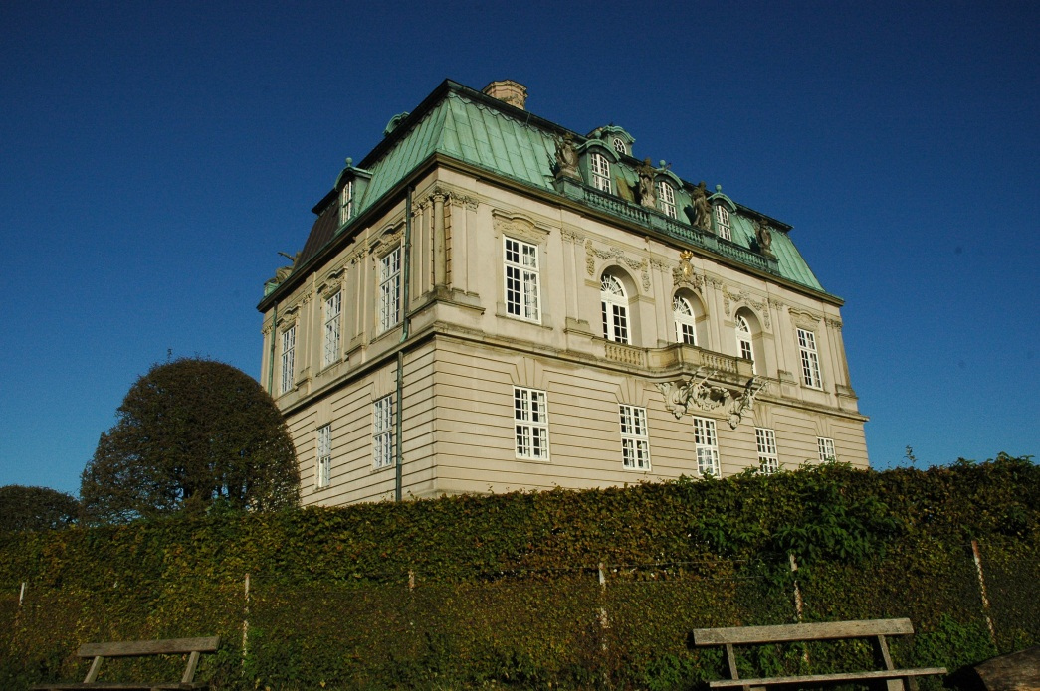
Matching patches
?
Raw pixel descriptor: Use pixels in patch and compare with Normalized Cross Correlation
Notes:
Is patch F1 similar to patch F2?

Slide 6
Open problems for raw pixel descriptor
What patch size should we use?
Use the detection scale and resample so both patches have equal size in pixels
Is this approach robust to scale changes in the scene?
Yes, if we do the resampling
Is this approach robust to rotation and translation in the scene?
No, this will lead to large dissimilarities
Is it robust to perspective distortions?
No, this will lead to large dissimilarities
Notes:
Lets consider an advanced approach which try to handle some of these problems

Slide 7
Scale Invariant Feature Transform (SIFT)
SIFT is a very popular descriptor (google.scholar says 26965 citations Nov. 2014).
Scale invariance:
This is obtained by using the DoG blob detector which is multi-scale. Descriptor build at these interest points in scale-space.
After detection we have an interest point at
Rotational invariance:
Estimate an orientation of the interest point and build the descriptor relative to this.
Translational invariance:
To some extend by construction of the descriptor (more on this)
Illumination invariance:
By construction of the descriptor (more on this)
Notes:
SIFT is popular and performs well, so lets go into details of what it does.
Several implementations available, but also patented.
16599 citations Nov. 2012

Slide 8
SIFT: The core idea Use gradient vectors
Notes:
SIFT use gradient vector orientations to describe the content of a patch.
Recall: The gradient measures changes in light. The gradient vector points uphill in direction of steepest ascent.
Draw on whiteboard a black and white pattern and point at zero gradient and high gradient areas.

Slide 9
SIFT
Notes:
The idea is to …
This is the overview – lets go into details with each step.
Orientation assignment is not even on this chart

Slide 10
SIFT: Rotational invariance by orientation assignment
At detection scale compute image gradients
Gradient orientation and magnitude images
Build a 32 bin orientation histogram for neighborhood around
Every point weighted with m and a Gaussian window
for all points in the image
Notes:
In SIFT Lowe find the closest scale level in the Gaussian pyramid and compute gradients using pixel differences.

Slide 11
SIFT: Rotational invariance by orientation assignment
Find highest peak and its orientation
Create an interest point descriptor using this orientation
For all other peaks larger than 80% of the highest peak – also create a descriptor using these orientations
degrees
Notes:
High peaks mean that we have many gradients pointing in this direction and / or very large gradients. Example: There is an edge near the interest point so its orientations will dominate.
Highest peak is at 170 degrees
Only the peak at 200 degrees is above 80% of the 170 degree peak – height 10
Now rotate the coordinate system for the rest of the analysis, and maybe resample a rotated patch in the original image.

Slide 12
SIFT descriptor
Orientation image
Gradient images
8-bin histograms
Notes:
The paper suggest 16x16 pixel initial patches, but it can be larger.
8 bin orientation histograms (45 degrees bin width)
4x4 grid of histograms
Orientation image uses pseudo colors to show orientation angle.

Slide 13
The SIFT descriptor: Details
8-bin orientation histograms:
When adding to bin, every data point is weighted with m and a Gaussian aperture window
Adding a data point to a bin also add a little to the neighboring bins (linear interpolation)
Pixels on the other side of a histogram grid border contributes a little to the histogram (linear interpolation)
Feature vector:
Concatenate 8-bin histograms from the 4x4 grid into one vector with dimensionality 4x4x8 = 128.

Slide 14
The SIFT descriptor: Details
Normalization of feature vector:
Normalize the feature vector:
Non-linear illumination changes (e.g. shadows) may cause high gradient magnitudes locally.
Therefore reduce all bin values larger than 0.2 down to 0.2.
Renormalize (normalize again):
Notes:
First normalization removes the multiplicative constant from an affine light transformation.
Second reduces effects from cast shadows (only partially)

Slide 15
SIFT descriptor
Orientation image
Gradient images
8-bin histograms
Notes:
The descriptor is now a vector of concatenated 8-bin histograms (128-dim. Vectors)

Slide 16
SIFT matching:
SIFT features are compared with Euclidean distance (L2-norm):
Matching SIFT features:
A match if this is true
Best refers to the distance for the pair of features with smallest distance.
2nd Best refers to the distance for the pair of features with second smallest distance.
Notes:
The sum runs over all the 128 dimensions of the SIFT feature.
Matching: The best match needs to be significantly better than other matches. Best distance <= Next_Best distance hence r <= 1.
This criterion is more stable than just using Best.

Slide 17
The SIFT descriptor invariance’s
Scale invariance:
From the (DoG) detector and further processing done at detection scale
Rotational invariance:
From the orientation assignment procedure
Approximate translational invariance:
From the detector and grid of histograms. Can handle translations up to 4 pixels (within a grid cell).
Affine illumination invariance:
From the choice of gradients additive brightness invariance is obtained. From normalization we obtain invariance to multiplicative contrast change.
Reduction of peaks gives some robustness to non-linear changes such as shadows.

Slide 18
Open problems for SIFT descriptors
Perspective distortion
Non-linear illumination such as cast shadows, changes to light color, and material reflection properties
It is fairly high dimensional (128 dim.) and redundant

Slide 19
Variations on SIFT
There are many variations of the SIFT descriptor:
GLOH
SURF
DAISY
PCA SIFT
Opponent SIFT
Gaussian opponent SIFT
CSIFT
ORB
BRISK
FREAK
…
Notes:
And many more with even more exotic names

Slide 20
DAISY – a common SIFT variation: Locations and spread of histograms
Notes:
Notice that DAISY is actually not using histograms but instead splits gradients to positive and negative parts.

Slide 21
What is the best detector and descriptor combination?
Based on joint work with Anders Dahl and Henrik Aanæs from DTU

Slide 22
Recall the DTU robot data set
Notes:
60 scenes, 119 camera positions, controlled lighting, and 3D ground truth

Slide 23
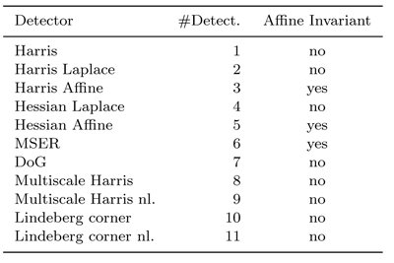
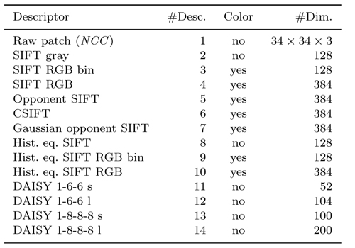
Detector - Descriptor Combination
Notes:
We look at all combinations of detector-descriptor from these tables (A matrix study)
Some descriptors work on color images.
Notice also the large variations in descriptor dimensionality

Slide 24
Evaluation Criteria
Extract features from the Key frame and another frame.
Matching criterion: Same as before except no scale
Compute: r = Best / 2nd Best < T
Compute ROC and AUC.
Use AUC as performance measure (average over scenes).
Notes:
Threshold T on distance ratio r and throw away all points larger than the threshold. Best <= Next_Best hence r <= 1
In ROC we change r to produce the curve.
In assignment 1, what I suggest you try is r < 0.8 and other threshold values.

Slide 25
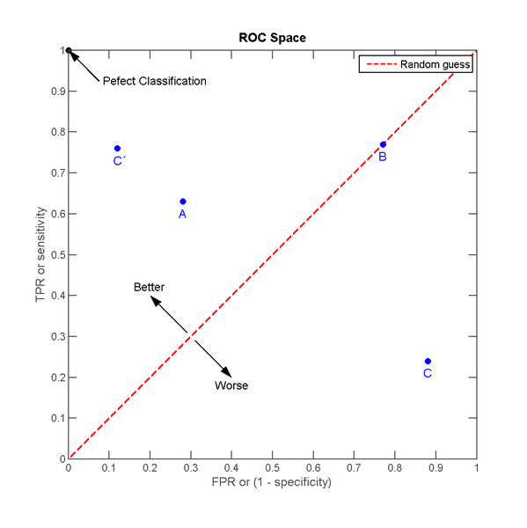
Aside: ROC and AUC?
Receiver operating characteristic (ROC):
TPR = TP / P (Recall)
FPR = FP / N
Area under the ROC curve (AUC):
AUC close to 1 is good
The probability of a correct match
From Wikipedia 2012
Notes:
ROC: Performance summary of binary classifiers (Match or No Match):
Confusion matrix: Summary of frequencies of different types of errors performed by the classifier.
TPR (True Positive Rate): Sensitivity or Recall. Ratio between true positives and all positives. Perfect classifier TPR = 1.
FPR (False Positive Rate): 1-specificity. Ratio between false positives and all negatives. Perfect classifier FPR = 0.
Random guess: Equal amount of False positives and False negatives errors.
As we vary r we get a curve (Draw example on whiteboard).

Slide 26
Evaluation Criteria
Extract features from the Key frame and another frame.
Matching criterion: Same as before except no scale
Compute: r = Best / 2nd Best < T
Compute ROC and AUC.
Use AUC as performance measure (average over scenes).
Notes:
Threshold distance ratio r and throw away all points larger than the threshold. Best <= Next_Best hence r <= 1
In ROC we change r to produce the curve.
In assignment 1, what I suggest you try is r < 0.8 and other threshold values.

Slide 27
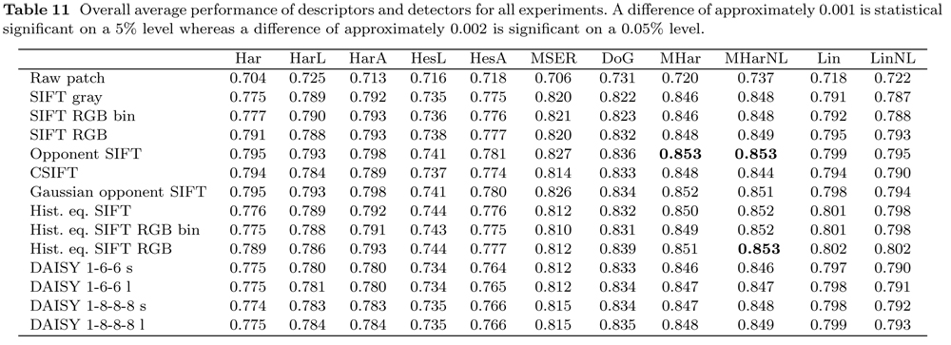
Results at a Glance
Notes:
These numbers are AUC estimates averaged over 60 scenes.
Significant level of 5% at distance 0.001 means that there is a 5% chance that they are not significantly different after all.
Notice the performance of Raw patch and NCC and compare with SIFT gray. Even though we have reduced the dimenensionality of the descriptor (not using the raw pixels) SIFT is better than raw patch.
Color based SIFT descriptors and multi-scale Harris points has the best performance.

Slide 28
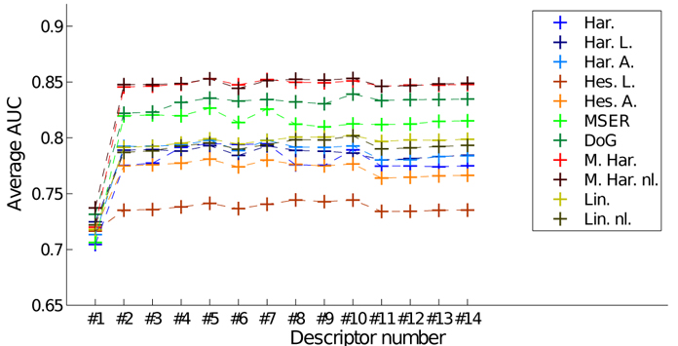
Results at a Glance, Detectors NB: Not Recall Rate
Notes:
A visualization of the previous table.
The performance ordering of detectors does not change as we change descriptors.
The curves also has the same shape for all detectors.
So detectors appear to have performance independent of the descriptor – not surprising

Slide 29
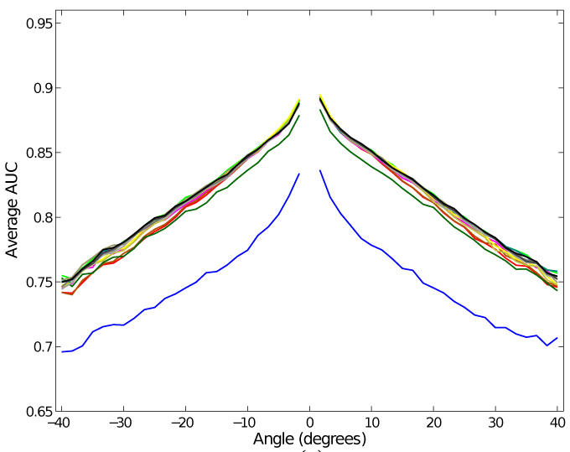
Results at a Glance, Descriptors
Notes:
Each curve represents a descriptor. The blue curve is Raw patch.
AUC averaged over scenes and interest point detectors.
The race is close – most (SIFT-like) descriptors have close to equal performance!

Slide 30
Outline of Findings
Multiscale Harris corner detector is the top performer.
With detectors the devil is in the details.
All SIFT based descriptors are almost created equal.
Light is very challenging.
On statistical significance…

Slide 31
Quote on Statistical Significance
“A question often overlooked by the computer vision community
when comparing results on a given dataset is whether the
difference in performance of two methods is
statistically significant.”
M. Everingham, L. Van Gool, C. K. I. Williams, J. Winn, A. Zisserman
“The PASCAL Visual Object Classes (VOC) Challenge”
International Journal of Computer Vision, Volume 88, Number 2,
page 303--338, 2010

Slide 32
Summary
Interest point descriptors:
SIFT and a note on variants
Comparison of interest point descriptors

Slide 33
Literature
Reading material:
Lowe IJCV 2004 (Sec. 5 – 7.1)
Dahl-Aanæs-Pedersen 3DIMPVT 2011
Additional material:
Larsen et al ECCV 2012
Notes:
Next year: Consider to include the ECCV 2012 paper as part of the lecture.

Slide 34
Lets have a break and then work with the assignment

Slide 35
Mandatory assignment 1: Feature extraction
Build and experiment with interest point detectors
Find matching points between two images

Slide 37
TODO: Add something on invariances, light, shading, color and shadows?

Slide 38
Are the histograms and grid important in SIFT?
TODO: Drop this?

Slide 39
The Jet representation
Taylor expansion of the image at (0,0) truncated at 2nd order:
Notes:
To answer this we need to introduce a model of an image patch – the jet representation.
With the Taylor polynomium we can reconstruct the patch at scale sigma (see figure).
We only need to store the derivatives to do this trick

Slide 40
The Jet representation
The k-jet of

Slide 41
TODO: Jet descriptor
Explain normalization steps
Explain configurations

Slide 42
TODO: Add highlights from Jet paper results (DoG points)
Or drop this?

